Slide 1

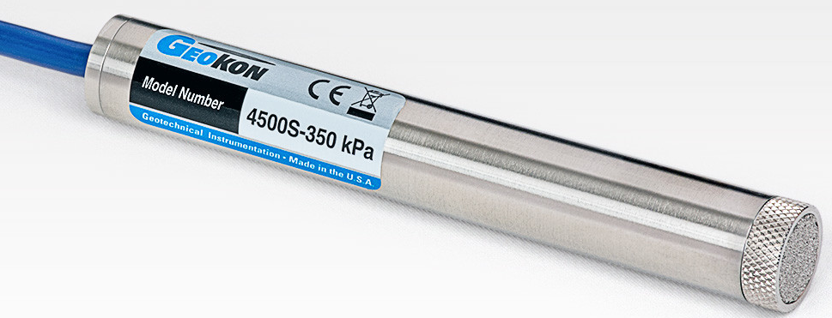
Vibrating Wire Piezometers

Slide 2
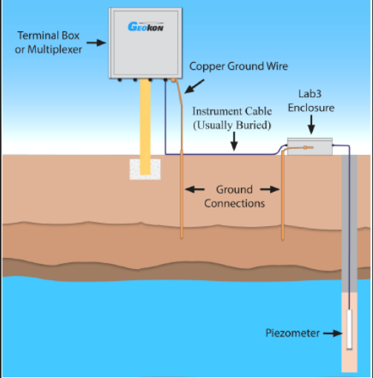
When and where VWPZ are used
Where its used
Borehole installation
Used for monitoring dams' concrete integrity
Used in areas with high risk of sink holes
Used for measuring ground water level in boreholes
Used for measuring pressure in industrial water flowing pipes

Slide 3
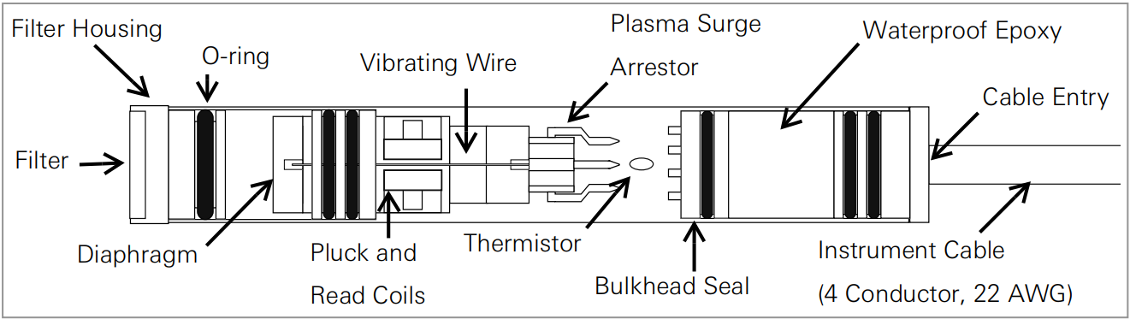
Internal diagram of VWPZ

Slide 4
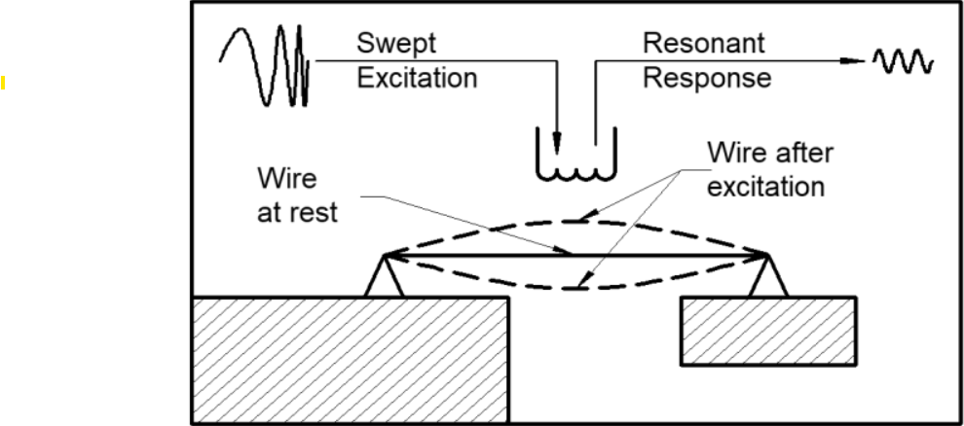

How it works
Pluck coil
Read coil
Vibrating Wire
Magnet

Slide 5
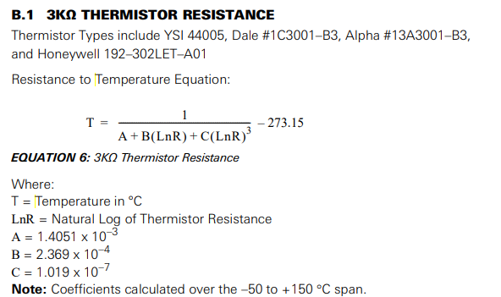
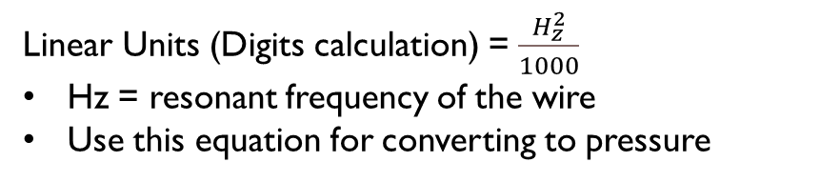
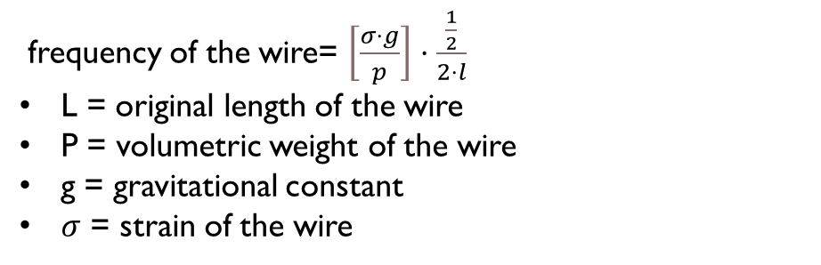
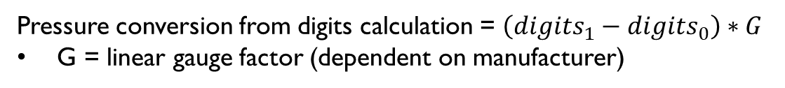
Equations
frequency of the wire= $\left[\frac{σ⋅g}{p}\right]⋅\frac{\frac{1}{2}}{2⋅l}$
L = original length of the wire
P = volumetric weight of the wire
g = gravitational constant
$σ$ = strain of the wire
Linear Units (Digits calculation) = $\frac{H_{z}^{2}}{1000}$
Hz = resonant frequency of the wire
Use this equation for converting to pressure
Pressure conversion from digits calculation = $\left(digits_{1}−digits_{0}\right)∗G$
G = linear gauge factor (dependent on manufacturer)

Slide 6
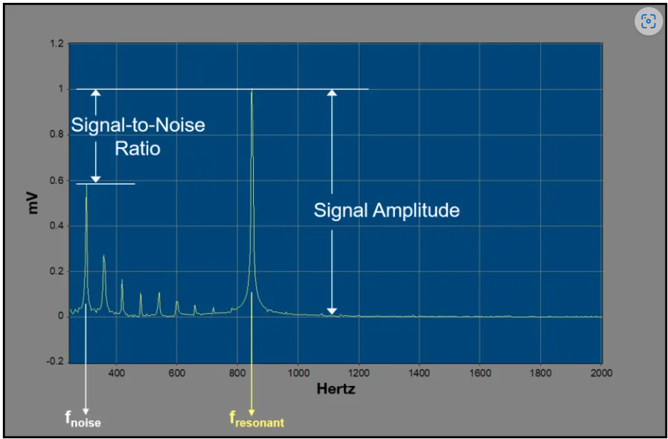
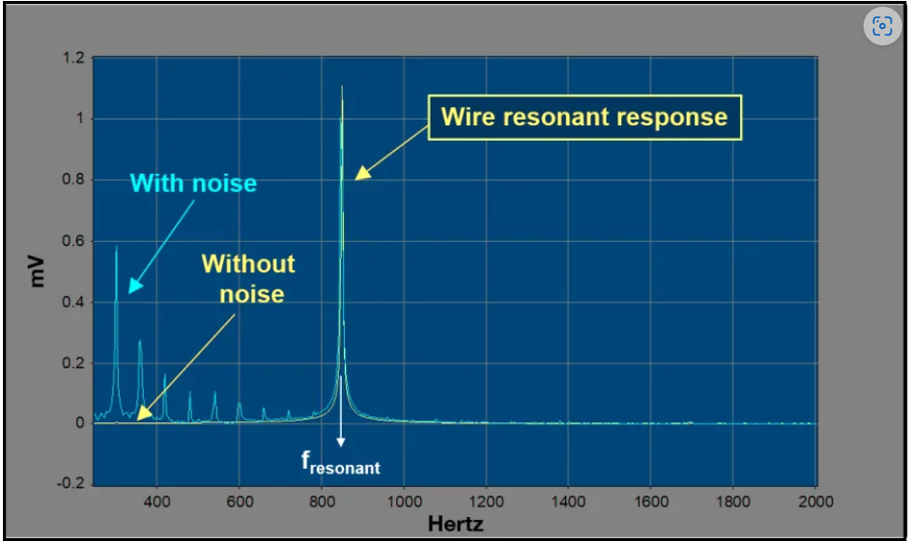
How its read
Frequency Response and SNR Comparison
Frequency Response and SNR Comparison

Slide 7
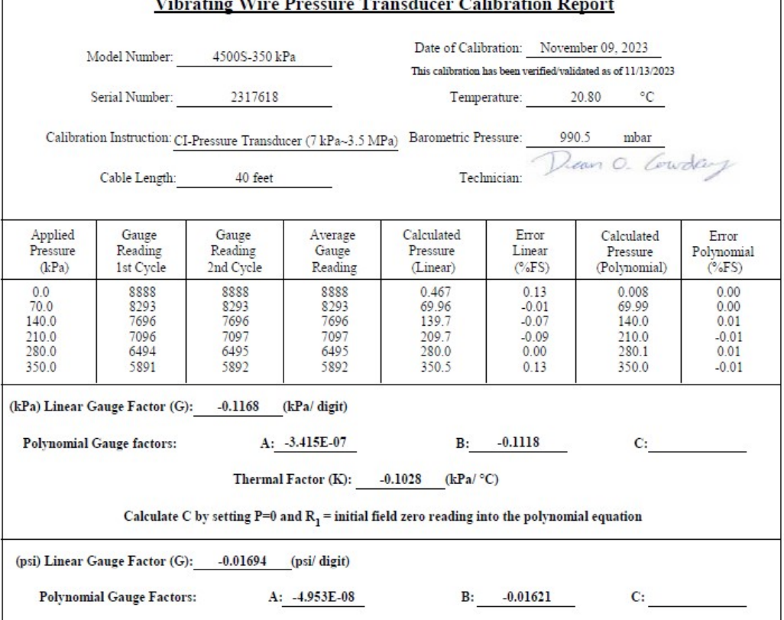
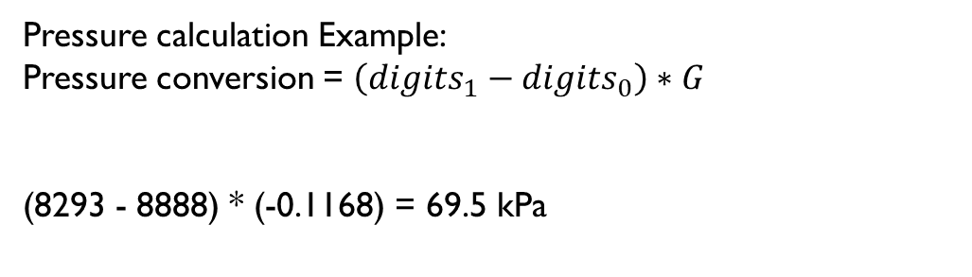
Calibration Example
Pressure calculation Example:
Pressure conversion = $\left(digits_{1}−digits_{0}\right)∗G$
(8293 - 8888) * (-0.1168) = 69.5 kPa

Slide 8
Work Cited
Model 4500 Series Vibrating Wire Piezometer - GEOKON, www.geokon.com/content/manuals/4500_Piezometer.pdf. Accessed 21 Mar. 2024.
“Reading Vibrating Wire Sensors: Spectral Analysis a Method to Determine the Resonant Frequency of Vibrating Wire Sensors with Improved Noise Immunity.” Reading Vibrating Wire Sensors: Spectral Analysis: A Method To..., www.campbellsci.com/vspect/spectral-analysis. Accessed 21 Mar. 2024.
“André Coyne.” Wikipedia, Wikimedia Foundation, 24 Aug. 2022, en.wikipedia.org/wiki/Andr%C3%A9_Coyne.

